Slide 1
Designing Your Defensive Monitoring Environment
Project 3
Project Week 1
Project 3
Project Week
‹#›

Slide 3

This Week:
In this project, you will play the role of an SOC analyst at a fictional organization called Virtual Space Industries (VSI).
VSI is a company that specializes in the design of virtual-reality programs for businesses.
VSI has heard rumors that a competitor, JobeCorp, may launch cyberattacks to disrupt VSI’s business.
As an SOC analyst, you are tasked with using Splunk to monitor against potential attacks on your systems and applications.

Slide 4

For your third project,
you will use the skills you learned in the Defensive Security unit to design a custom monitoring environment to protect a fictional organization.
Notes:
shutterstock_1200423583

Slide 5
Defensive Security
In the Defensive Security unit, we’ve covered:
Information security continuous monitoring (ISCM)
Log types and how they are used for monitoring
Log aggregation and correlation
Baselining
SIEMS
Splunk

Slide 6

Group Work
This is a group project.
You will complete this project in groups, but every student is required to remain in class.
Groups are permitted to split up the work on this project, but each student must submit all project deliverables.
Each day builds on the previous day’s work to complete the project, and each day’s activities must be completed in order.
Notes:
shutterstock_1815485210

Slide 7


This Week:
You are tasked with monitoring the following VSI products:
An administrative webpage:
https://vsi-corporation.azurewebsites.net/
An Apache web server,
which hosts this webpage.
A Windows
operating system,
which runs many of VSI’s back-end operations.
Your networking team has also provided you with past logs to help you develop baselines and create reports, alerts, and dashboards to protect VSI from any attacks by JobeCorp.

Slide 8
This Week’s Daily Structure
Class will run a little differently during project week. Each day will include:
Brief Lecture
Brief Overview
Daily Guides
We will begin by introducing some new concepts.
Then, we’ll review the day’s project tasks.
Finally, you’ll use a guide to complete the project tasks during the remaining class time.
Day 2’s guide concludes with review questions, which you’ll submit at the end of the project.

Slide 9
Daily Objectives and Milestones
You will be given logs of “typical” business functions in order to understand VSI's environment.
Day 1
You will develop a defensive solution utilizing a variety
of Splunk tools you learned in class in order to protect VSI.
You will use these logs to create baselines and then design custom alerts, reports, and dashboards.
Additionally, you will download and use a Splunk “add-on” app of your choice to monitor against other types of attacks.

Slide 10
Daily Objectives and Milestones
You will analyze the reports and dashboards that you created on Day 1 in order to determine whether your defensive choices protected VSI from these attacks.
Day 2
VSI will experience
a simulated cyber attack.
You will be provided with and answer review and analysis questions.
Additionally, you will start preparing slides to present your findings on Day 3 of class.

Slide 11
Daily Objectives and Milestones
In your groups, you will present:
You will discuss how well or poorly it alerted and protected against the simulated attacks.
Day 3
You will present the defensive solution you created.
You will suggest any adjustments you would make to your defensive solution.

Slide 12
Project Deliverables
The project is due one week from the third day of this project. There is no additional Challenge this week. You will submit the following project deliverables:
Technical Brief and Review Questions
Presentation Slides
Provide answers to a series of questions explaining your monitoring solution and its efficacy at defending against attacks. Screenshots of your monitoring solution will also be submitted with this document.
Submit the slides your group uses
for Day 3’s presentation.

Slide 13
Today’s Class
The rest of today’s class will proceed as follows:
Introduction to the project scenario
Overview of
today’s tasks
Project work

Slide 14

Day 1 Overview

Slide 15
Day 1 Project Overview
On Day 1, you will complete the following:
Load and analyze Windows logs.
Create reports, alerts, and dashboards for the Windows logs.
Load and analyze Apache logs.
Create reports, alerts, and dashboards for the Apache logs.
Install an add-on Splunk application for additional monitoring.

Slide 16

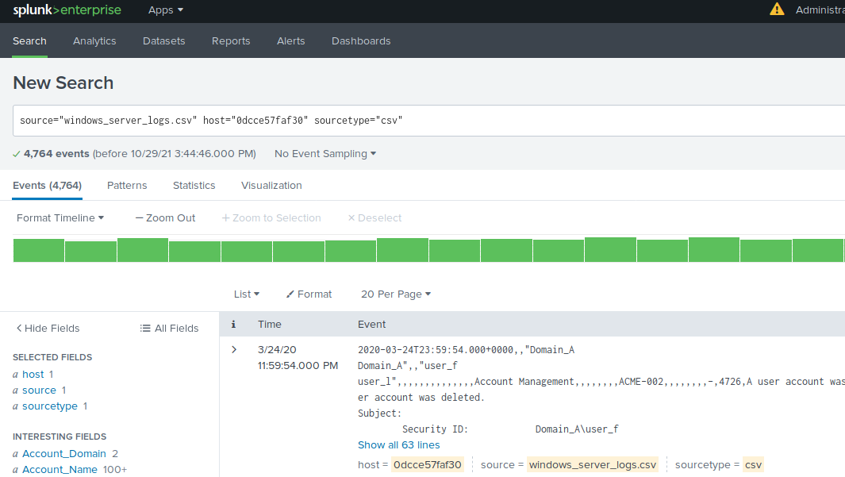
Step 1
Load and Analyze Windows Logs
You will be provided with
a set of logs from the Windows servers that run VSI’s back-end systems.
The logs represent normal business operations.
You will load these logs
and analyze the data they contain to determine baselines of normal activity.

Slide 17
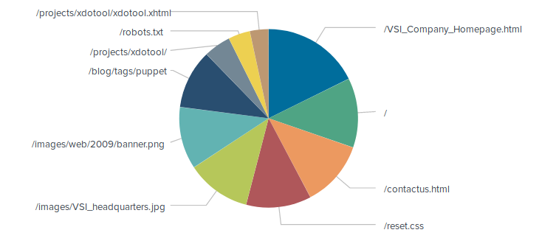

Step 2
Create Reports, Alerts, and Dashboards for the Windows Logs
Then, you will create reports, alerts, and dashboards based on your research in the previous step. You’ll use these reports, alerts, and dashboards to determine if a future attack occurs.
Important:
You must grab screenshots where indicated in the daily guide. You will add them to your presentation.

Slide 18
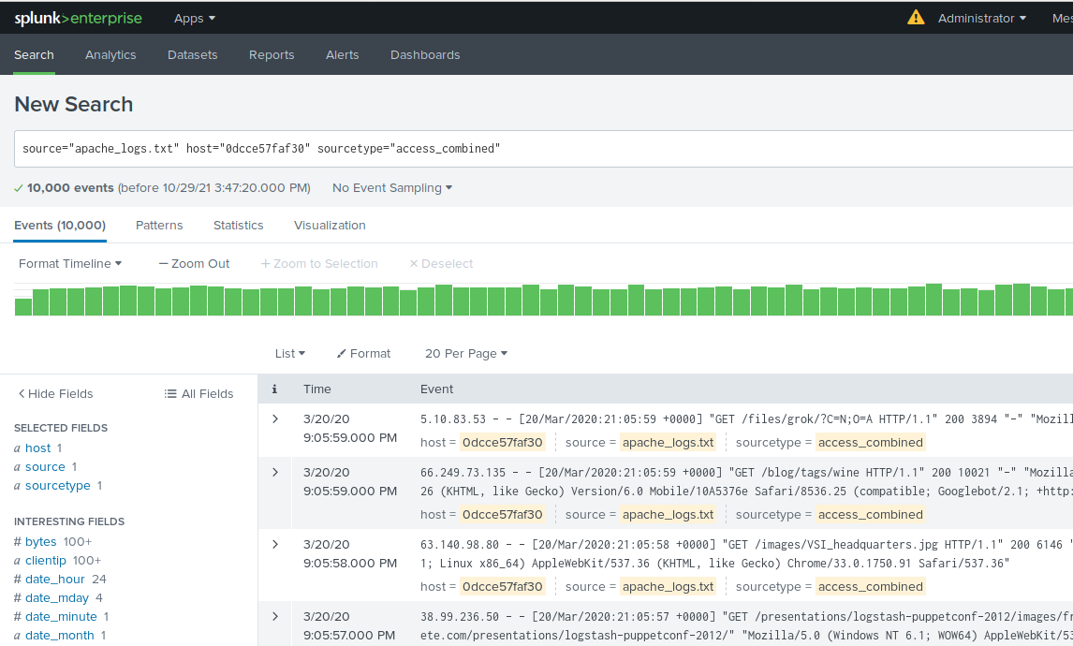
Step 3
Load and Analyze Apache Logs
Next, you will be provided with a set of logs from the Apache web servers that host VSI’s web application. The logs represent normal business operations.
You will load these logs and analyze the data they contain to determine baselines of normal activity.

Slide 19
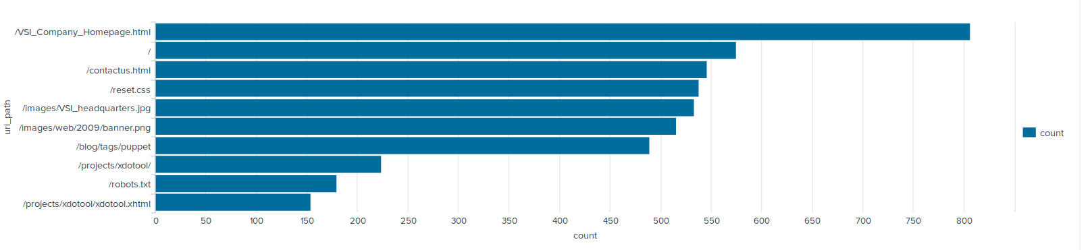
Step 4
Create Reports, Alerts, and Dashboards for the Apache Logs
Then, you will create reports, alerts, and dashboards based on your research in the previous step. You’ll use these reports, alerts, and dashboards to determine if a future attack occurs against VSI’s web server.

Slide 20
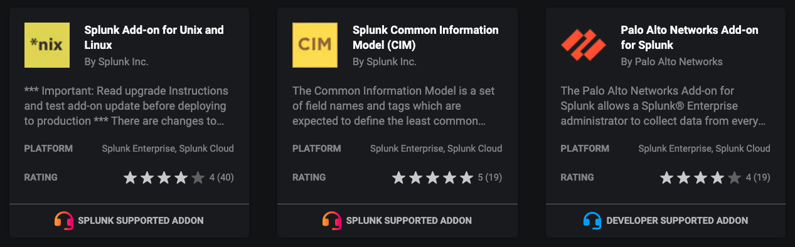
Step 5
Install Add-On Splunk Applications for Additional Monitoring
You will choose one of several Splunk add-on apps to assist with monitoring.
You will install the app and configure it to protect VSI’s systems.

Slide 21

Group Assignments

Slide 22
Building a Security Monitoring Environment — Day 1
In this project, you will design reports, alerts, and dashboards, and select and install a Splunk add-on app in order to protect VSI from attacks.
To end of class

